Slide 1
Coast Salish Design
Vocabulary

Slide 2
Coast Salish Design
Coast Salish design is made up of an outline that forms the overall picture and connects everything in it. This shows that everything is connected: humans, the natural world and the universe.
Coast Salish artists use the design elements to make artworks that are a map or guide of the spiritual world, away from the rules of time and space and moves us into the supernatural realm or open as a pathway for the spiritual beings to enter our earthly world.

Slide 3
Coast Salish Design Vocabulary - Crescent
Understood as phases – like that of the moon or life
Marks the passage of time in seasons rather than weeks, months, years
Evening hours are the best time to teach and counsel, the nighttime fire is a tool for visualization as the flames display many forms of the crescent
It mimics the shapes of the flames, as the repeated crescent shapes in Coast Salish art focus our eyes on the visual information shown

Slide 4
Coast Salish Design Vocabulary - Crescent

Slide 5
Coast Salish Design Vocabulary - Trigon
The trigon reflects light
It has four points: three surface points and a fourth inner point
Four is an important ritual number and is central to Coast Salish teachings
Four major directions and they are offered to four times
Four parts of human nature – the physical, the mental, the emotional and the spiritual

Slide 6
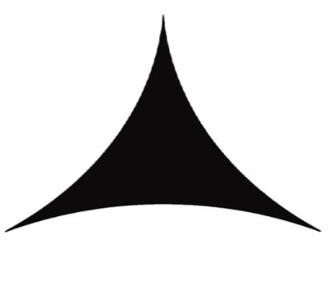
Coast Salish Design Vocabulary - Trigon

Slide 7
Coast Salish Design Vocabulary - Circle
The circle is a prominent design element in Coast Salish art
Represents unity and centrality
is seen throughout nature – the sun, moon and sky
Represents the cycles of the season, nature and human life
Expresses philosophy of closure, completion and employment
Reminds us that all things are connected, that our actions affect ourselves, our people, future generations and the earth

Slide 8
Circle

